Slide 1
STRATEGIC PLANNING

Slide 2
INTRODUCTION

Slide 3
WHY WE DO IT?
Bad events will occur on your watch
No one else is going to do it
Demonstrates the ability to manage time
Shows vision
Proves long term commitment
Builds a nice resume
Enhances value

Slide 4
WHY WE DO IT (dig a little deeper)?
Some doctors want a sense of mission/direction
Most doctors want to know where they stand
Uncertainty can breed complacency
Secures your future
Positions you for further action
It is better for everyone

Slide 5
HOW YOU DO IT?
Events
Certain to happen
Probable to happen
Possible to happen

Slide 6
HOW YOU DO IT?
Timing
Less than 3 months
3 months to 1 year
1 year-5 years
More than 5 years

Slide 7
HOW YOU DO IT?
Impact
Very Bad
Bad
Good
Very Good

Slide 8
HOW YOU DO IT?
Begin with an event certain to happen in a short time frame
Pick one you can win quickly
Make a list of issues surrounding the event
Break it into small projects

Slide 9
HOW YOU DO IT?
Seek input and investigate
Deal with problems immediately
Assignments
Follow through and accountability
Decide if facilitator is needed

Slide 10
FINISH AND PRESENT IT!
Pick the right time and place
Document success and present evidence
Deliver(y) progress in small bites
Quantify impact

Slide 11
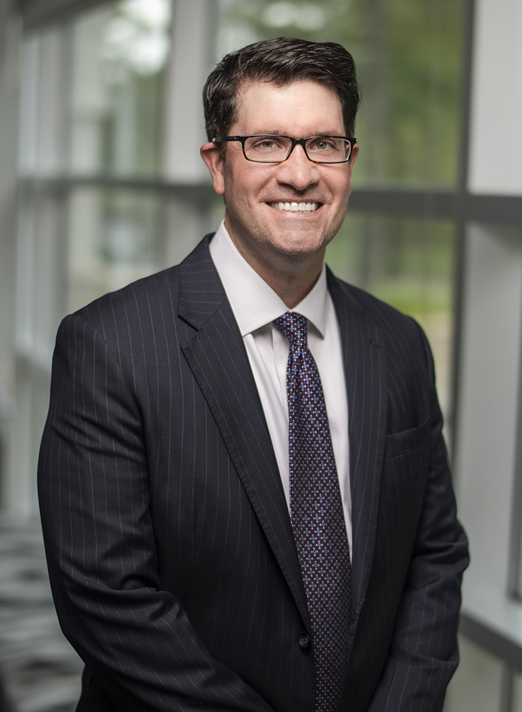
D. MADDOX CASEY, CPA
Partner
2500 Acton Road | Birmingham, AL
Office 205.769.3392
Maddox.Casey@warrenaverett.com

