Slide 1
Practice Perfect
Tips & Tools for Proactive Process Perfection
Stacie Jenkins, MSN, RN, CPSO
Vice President, Patient Safety & Risk

Slide 2
Objectives
Discuss why FMEA is useful as a proactive risk management tool.
Learn how to complete an FMEA.
Learn how to identify areas that may be problematic for performance improvement.

Slide 3
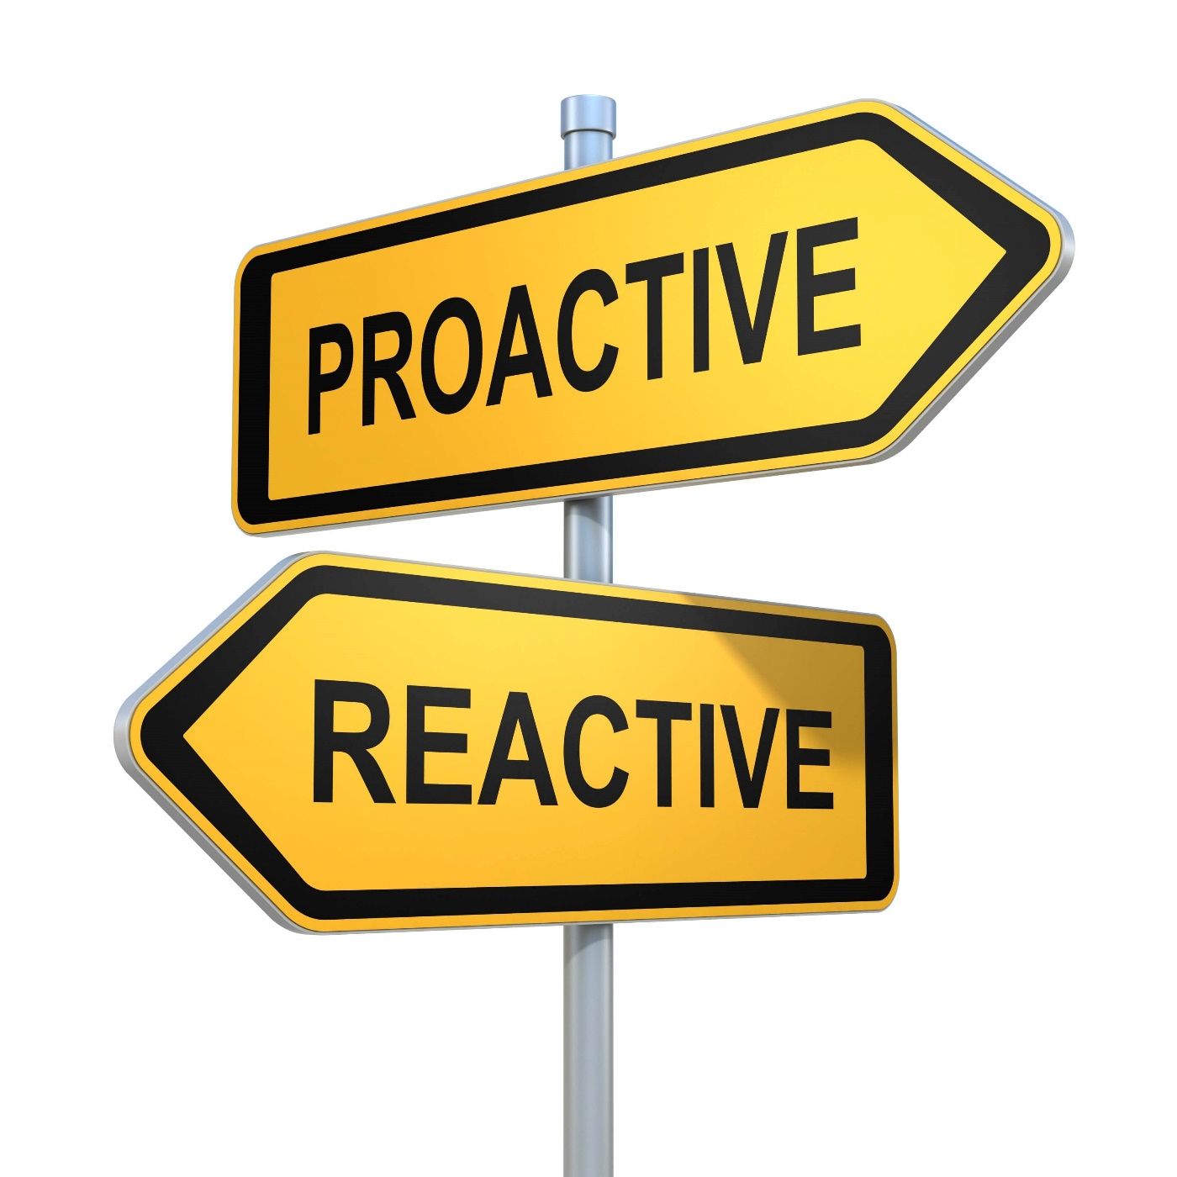
Reactive vs. Proactive
What is your approach?
Notes:
The answer is really both. Depends on what you have to address.

Slide 4
Always Reactive?
Learn
Evaluate
Improve
Prevent
Notes:
If you are always reactive, then you are always putting out a fire and addressing something that has already happened. Sometimes you have to. You have to address a patient complaint, or a patient who falls, etc. When these things happen, we have to learn from our experiences, evaluate the situation and improve processes according to prevent them from happening again.

Slide 5
What if…
Evaluate
Identify
Implement
Prevent Harm
Notes:
What if I could show you how to use a tool that would help you evaluate processes before events occur to help you determine where problems might arise so you can fix the problems before harm occurs? Would you be interested?
Well today I’m not only going to talk to you about it, I’m going to show you how to do it.

Slide 7
What is FMEA?
FAILURE
MODE
EFFECTS
ANALYSIS
Notes:
Proactive approach to identifying problematic steps (failures) in a process that could lead to adverse events (effects).

Slide 8
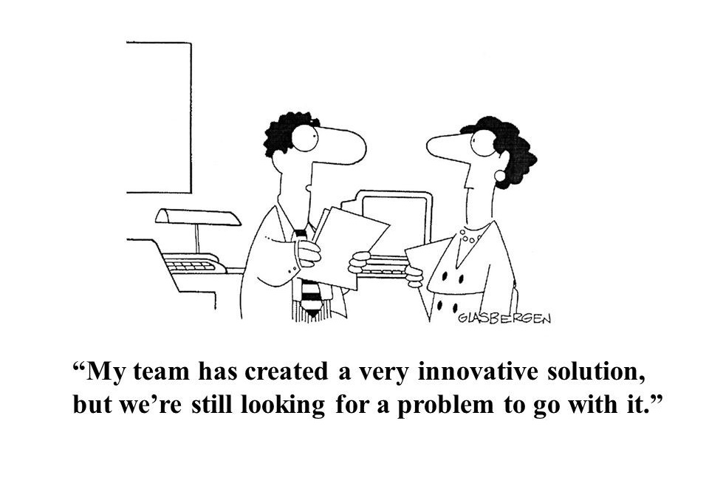

Slide 9
Tips to Remember
Team
Process
Tool
Service
Notes:
Interdisciplinary team
Choose a process very, very specific; use of flowcharting might help
Tool – use a tool to help guide you; this is a PI process; doesn’t have to be fancy just consistent
Use for new service that you’re thinking through or existing one that is high-risk

Slide 10
What are the steps in the process?
Notes:
Team needs to agree on the steps in the process.
Great idea is to flowchart the process on a whiteboard, flipchart, etc.

Slide 11
FMEA Spreadsheet
Steps in Process | Failure Mode | Failure Causes | Failure Effects | Likelihood of Occurrence (0-10) | Likelihood of Detection (0-10) | Severity (0-10) | Risk Profile Number (RPN) | Actions to Reduce Occurrence of Failure
1
2
3
Notes:
Each of the steps the team determines for the process gets entered into this table. You will need to evaluate each step using the criteria in the heading.

Slide 12
Failure Modes
Steps in Process | Failure Mode | Failure Causes | Failure Effects | Likelihood of Occurrence (0-10) | Likelihood of Detection (0-10) | Severity (0-10) | Risk Profile Number (RPN) | Actions to Reduce Occurrence of Failure
1
2
3
Notes:
Start with the first 3.

Slide 13
Failure Definitions
FAILURE MODE
FAILURE CAUSES
FAILURE EFFECTS
What would be the consequences of failure?
Why would failure happen?
What could go wrong?
Notes:
Failure Mode: List anything that could go wrong during that step in the process.
Failure Causes: List all possible causes for each of the failure modes you’ve identified.
Failure Effects: List all possible adverse consequences for each of the failure modes identified.

Slide 14
Likelihood
Steps in Process | Failure Mode | Failure Causes | Failure Effects | Likelihood of Occurrence (0-10) | Likelihood of Detection (0-10) | Severity (0-10) | Risk Profile Number (RPN) | Actions to Reduce Occurrence of Failure
1
2
3
Notes:
Rate each FM in the list.
Scale of 0-10

Slide 15
Likelihood Definitions
OCCURANCE
DETECTION
SEVERITY
How likely if the FM occurred will it NOT be detected?
How likely will the FM result in severe harm if it occurs?
How likely will the FM occur?
Notes:
Likelihood of Occurrence (1–10): On a scale of 1-10, with 10 being the most likely,
what is the likelihood the failure mode will occur?
Likelihood of Detection (1-10): On a scale of 1-10, with 10 being the most likely NOT
to be detected, what is the likelihood the failure will NOT be detected if it does occur?
Severity (1-10): On a scale of 1-10, with 10 being the most likely, what is the likelihood
that the failure mode, if it does occur, will cause severe harm?

Slide 16
Calculate RPN
Steps in Process | Failure Mode | Failure Causes | Failure Effects | Likelihood of Occurrence (0-10) | Likelihood of Detection (0-10) | Severity (0-10) | Risk Profile Number (RPN) | Actions to Reduce Occurrence of Failure
1
2
3
Notes:
Risk Profile Number (RPN): For each failure mode, multiply together the three scores
the team identified (i.e., likelihood of occurrence x likelihood of detection x severity). The
lowest possible score will be 1 and the highest 1,000. To calculate the RPN for the entire
process, simply multiply all of the individual RPNs for each failure mode.
Use as a PI tool by re-evaluating the process and re-calculating the RPN numbers after change is implemented to determine if the RPN has been lowered.

Slide 17
Plan of Action
Steps in Process | Failure Mode | Failure Causes | Failure Effects | Likelihood of Occurrence (0-10) | Likelihood of Detection (0-10) | Severity (0-10) | Risk Profile Number (RPN) | Actions to Reduce Occurrence of Failure
1
2
3
Notes:
Actions to address failure modes.

Slide 18
Let’s give it shot!

Slide 19
Stacie Jenkins, MSN, RN, CPSO
Vice President, Patient Safety & Risk
(318) 368-3823
StacieJenkins@LHATrustFunds.com
Lindsay Minzey
Business Development Specialist
(225) 202-3127
LindsayMinzey@LHATrustFunds.com

