Slide 1
Part 1: The Family Glitch Fix and The Rise of Individual Health Insurance Coverage Part 2: GLP-1 Drugs and the Impact on Premiums
By Mike Bertaut
Healthcare Economist, Exchange Coordinator
Summer 2023

Slide 2
What’s the “Family Glitch?” And Why Did It Need Fixing?
In 2010 the passage of the Affordable Care Act put new obligations on larger employers, typically ones with 50 employees or more:
One of those obligations was a requirement to offer their employees who worked more than 30 hours/week coverage.
That coverage had to meet both QUALITY and AFFORDABILITY standards.
Once the employer met those standards, he could avoid federal fines that could get quite large.
Unfortunately, no affordability standard was established for DEPENDENT or SPOUSE coverage.
This meant employers could meet their obligations under the ACA by offering dependent/spouse coverage but putting $0 money into it.

Slide 3
How Has It Been Fixed?
Unfortunately, even the OFFER of unsubsidized, potentially very expensive coverage would freeze the spouse/dependent out of tax credits for individual coverage on healthcare.gov!
The IRS has issued a final rule that potentially solves the problem without putting a direct cost on the employer:
Re-compute affordability using the entire family (tax household) as the basis.
Allow non-employee family members with premiums above a certain income threshold (9.12% of HH income for 2023) to pass on the employer offer and access advanced premium tax credits to purchase individual coverage on Healthcare.gov.
Keep the same standards as before for the employer/employee relationship.
The Determination of Unaffordable Coverage triggers a special enrollment period (newly unaffordable)
Affordability MUST be computed on the cheapest plan available, even for spouse/dependents.

Slide 4
10 Worst States For Employer Contributions to Family Coverage (KFF)
STATE | AVERAGE ANNUAL EMPLOYER CONTRIBUTIONS TO FAMILY COVERAGE | TOTAL AVERAGE ANNUAL FAMILY PREMIUMS
ARKANSAS | $11,837 | $18,339
LOUISIANA | $12,574 | $19,305
HAWAII | $12,589 | $18,539
OKLAHOMA | $12,886 | $20,108
ARIZONA | $13,026 | $20,117
UTAH | $13,071 | $19,844
ALABAMA | $13,293 | $19,539
IDAHO | $13,473 | $19,788
KANSAS | $13,568 | $19,237
MISSISSIPPI | $13,830 | $20,373
Note that if we remove the contributions of government and union groups, the Louisiana contribution drops to about $4,000 a year on average.

Slide 5
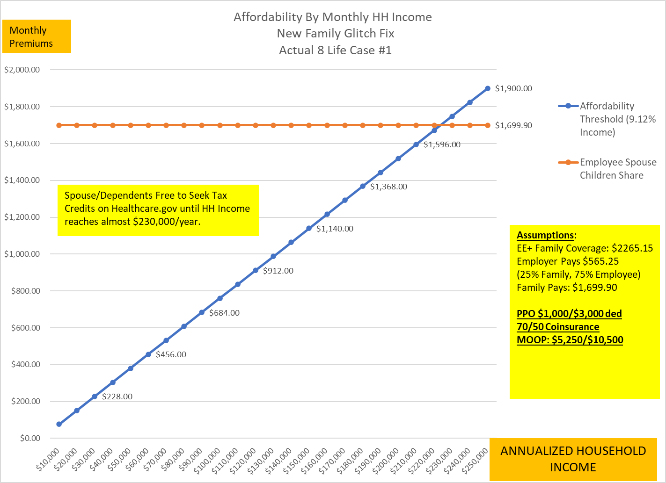

Slide 6
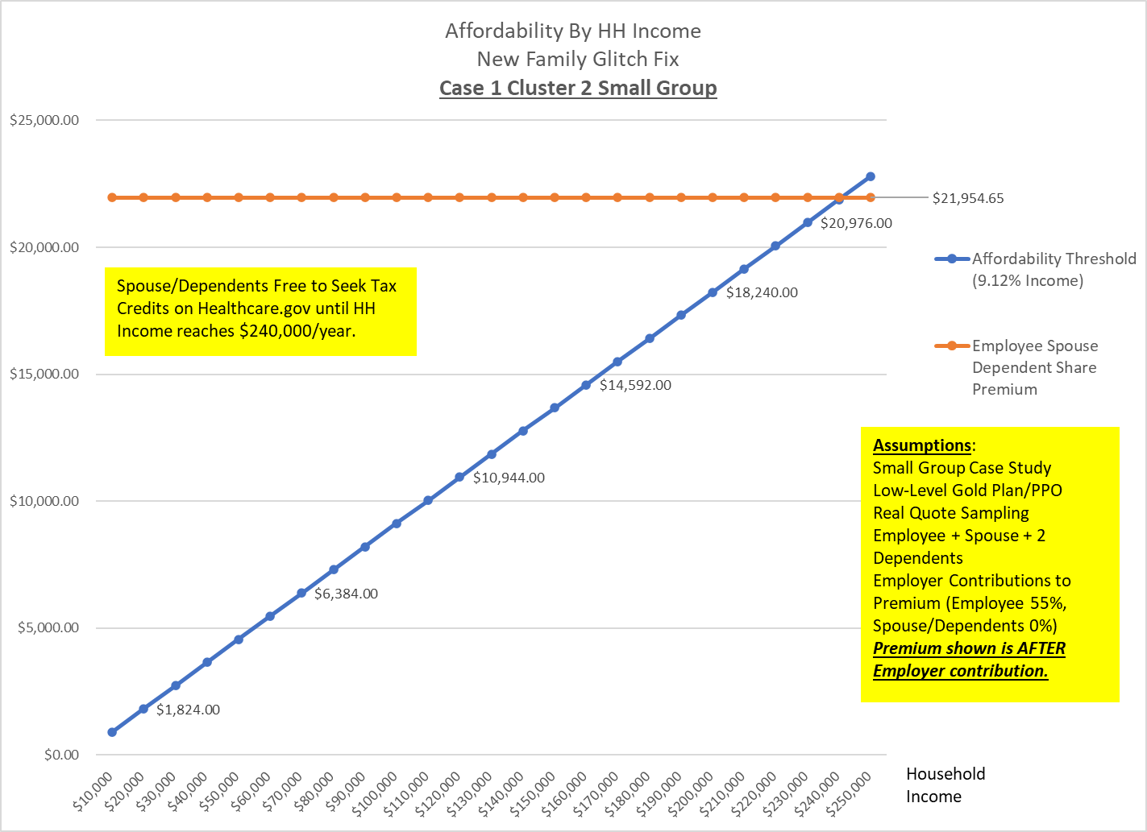

Slide 7
In Exchange for More Money, States Stopped Screening their Existing Medicaid populations…
Screening for income, residency and other eligibility criteria in Medicaid stopped in May 2020 as a reaction to COVID.
As a result, Medicaid has grown by 22 MILLION people nationally since then.
States estimate between 7% and 33% of their Medicaid populations will lose coverage in the next 12 months.
Most states have already begun screening and will start notifying members in April of their new status.
Those losing Medicaid will have three options:
Seek coverage through their/relative’s employers
Seek coverage through their Marketplace (Healthcare.gov in Louisiana)
Allow themselves to become uninsured
Up to 15 million people will lose coverage in the next 12 months.

Slide 8
Reconnecting People to Coverage
Dis-enrollments are underway!!!!
BCBS plans are making targeted investments in organizations that serve the affected community to help them add resources.
Licensed agents all over the nation will help the newly uninsured find new coverage without any cost for their services or any obligation to buy anything.
The goal is a smooth transition.
Complicating Factors:
Medicaid coverage is free. That is, participants don’t pay premiums deductibles or copays, or have to worry about maximum out of pocket costs.
Private coverage, no matter what the source, will have costs associated with all of these areas.
The lowest premium plans on Healthcare.gov may have very high deductibles and maximum out-of-pocket costs.
Guidance is key! There are also plans that require almost NO out-of-pocket costs if income is just a bit above the Medicaid threshold.

Slide 9
STLDI Changes Incoming……
Proposed rule would undo Trump-era changes to the sale of short-term limited duration medical insurance.
Move maximum contract length from 364 days to just 90.
Maximum time per year covered down to 120 days.
No renewals with same carrier for 1 year after contract ends
No changes to coverage requirements
No marketing allowed (and probably no sales at all) during Healthcare.gov open enrollment
Those enrolled on change date are grandfathered under the old rules.

Slide 10
GLP-1 Drugs For Type 2 Diabetes and for Non-Diabetic Obesity and the Potential Impact on Premiums
By Mike Bertaut
Healthcare Economist, Exchange Coordinator
Summer 2023

Slide 11
PARTIAL LIST OF THE STUDIES USED FOR THIS ANALYSIS AND MODELING
Obesity research links, diabetic and non-diabetic
https://www.ncbi.nlm.nih.gov/pmc/articles/PMC5319814/
https://diabetes.org/about-us/statistics/cost-diabetes
https://www.cdc.gov/diabetes/library/spotlights/diabetes-facts-stats.html#:~:text=Key%20findings%20include%3A,t%20know%20they%20have%20it.
https://www.hsph.harvard.edu/obesity-prevention-source/obesity-consequences/economic/
https://www.ncbi.nlm.nih.gov/pmc/articles/PMC2891924/
https://www.jmcp.org/doi/10.18553/jmcp.2021.20410
https://pubmed.ncbi.nlm.nih.gov/33470881/#:~:text=RESULTS%3A%20Adults%20with%20obesity%20in,to%20233.6%25%20for%20class%203.
https://milkeninstitute.org/sites/default/files/reports-pdf/Mi-Americas-Obesity-Crisis-WEB.pdf
https://atm.amegroups.com/article/view/89415/html
https://jamanetwork.com/journals/jamanetworkopen/fullarticle/2796491
https://www.stlouisbariatrics.com/obesity/obesity-and-the-cost-of-diabetes/

Slide 12
Population Health Type 2 Diabetic Statistics
37 million Americans (out of 335 million people, roughly 11% of us) have Type 2 diabetes.
Type 2 represents 95% of all diagnosed diabetes cases.
In Louisiana the number is higher, 14.5% (505,000 people).
85% of Type 2 diabetics were obese when diagnosed (BMI 30+).
About 38% of Louisiana’s population is BMI 30+
About 30% of BCBSLA’s covered lives are BMI 30 or higher
***Multiple studies used from 2016-2022 sourced from Harvard Medical, US CDC, US NIH, the American Diabetes Association and the American Hospital Association

Slide 13
Lesser-Known Stats About Type 2 Diabetes and Non-Diabetic Obesity
The actual progression of an obese population to Type-2 Diabetes (A1C 7% or higher) is not well understood and very difficult to predict on a case-by-case basis.
0.9% of the adult BMI 30+ population present with Type-2 Diabetes in an average year (2022, ~9 per 1,000 obese)
Up to age 33, the conversion rate is 0.3% (3 per 1,000)
Estimates of the incremental direct healthcare costs of Type 2 diabetics (over non-obese, non-diabetic folks at the same age) range from $495 pmpm to $1,105 pmpm in extra costs.***
Estimates of the incremental costs of non-diabetic obesity range from $125 pmpm to $254 pmpm.
***Multiple studies used from 2016-2022 sourced from Harvard Medical, US CDC, US NIH, the American Diabetes Association and the American Hospital Association

Slide 14
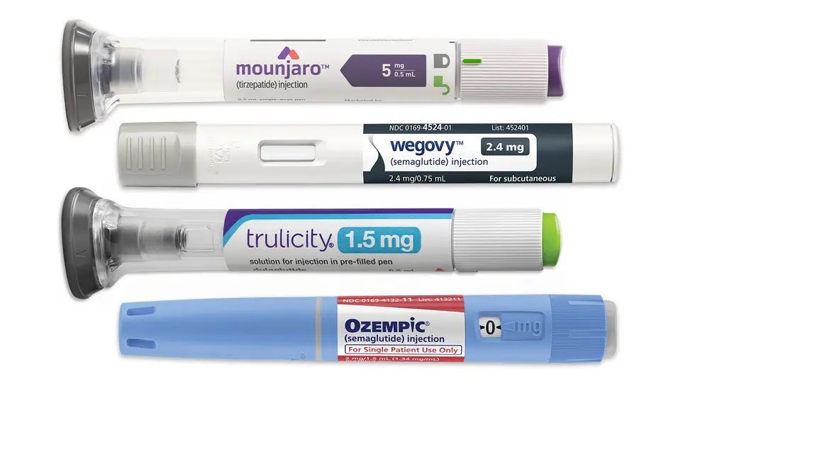
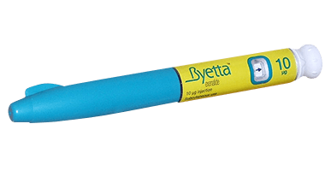
GLP-1 Drugs in 2023
Typically given by injection weekly.
Single Month Supply is 4 Pens
Help the body regulate glucose levels
Slow digestion and create a feeling of being “full” most of the time via hormone suppression.
Very good at regulating glucose levels in diabetics
Return 5-25% weight loss in patients who use them
They are not a “cure” for obesity. People who stop taking them typically regain most lost weight in 6 months.
Monthly pricing (July 2023) ranges from $900 to over $1,350 per month’s supply.

Slide 15
Contraindication Considerations: Gastroparesis
Gastroparesis, also called delayed gastric emptying, is a disorder that slows or stops the movement of food from your stomach to your small intestine, even though there is no blockage in the stomach or intestines.
2% of the general population is affected by GP at some point in their lives.
In Type 2 diabetics, the % is higher (~4%) and more persistent when diagnosed.
Although the affected % is unknown at this time, significant reports of extended GP even after discontinuing GLP-1 drugs for a year or more have been recorded.
New Mayo clinic studies (small scale Liraglutide) showed stomach emptying on GLP-1’s slowed from an average of 4 minutes to between 75 and 150 minutes.
Standard contraindications include nausea, vomiting, stomach pain, bloating, gas, and other GI issues.

Slide 16
Contraindication Considerations: Suicide Ideation
So far officially limited to a few cases using Liraglutide and Semaglutide in Iceland.
The European Medicines Agency has instructed its Pharmacovigilance Risk Assessment Committee to conduct widescale surveys of patients taking GLP-1 drugs.
In the US, NovoNordisk has advised physicians prescribing Wegovy to screen patients for depression.
Germany has just approved GLP-1 drugs for weight loss in the last few months, studies on mental health will happen at the same time.
So far, nothing definitive on the level of increase of suicidal thoughts by GLP-1 drug use.

Slide 17
Modeling Considerations
GLP-1’s for Type 2 diabetes versus non-diabetic obesity
Cases for display involve a 3,000-member group, and a 500,000 member Louisiana-based at-risk carrier population.
Monthly results for 36 consecutive months, with “savings” kicking in beginning in month 6.
Cost-avoidance set at the average of the major, most recent studies, i.e. $198.50 pmpm for non-diabetic obesity, and $796.25 pmpm for Type-2 diabetes.
Normal conversion of Obese to Type 2 allowed throughout the model, and avoided conversion savings included.
Total healthcare spend, and drug-only spend estimated for both groups using current fully insured group % of earned premiums (2022).
Take-rate assumptions at 80% of max expected for Type-2 diabetes model, less than half within non-obese diabetic model (conservative case)

Slide 18
Financial Simulation #1: GLP-1 Coverage for Type 2 Diabetes (36 Month Simulation)
Model Parameters | Employer Model | Carrier Model
Covered Lives (Members) | 3,000 | 500,000
Type 2 Diabetics | 426 | 72,500
Total 3 Year Medical Spend w/o GLP-1 | $38 Million | $6.3 Billion
Expected 3 Year Drug Spend w/o GLP-1 | $9.5 Million | $1.575 Billion
GLP-1 Diabetic Enrollment | 75% Year 1, 90% Year 2, 95% Year 3 | 50% Year 1, 75% Year 2, 85% Year 3
Total GLP Prescription/Months (3 Years) | 12,418 | 1,551,178
GLP-1 Spend @ $900 pmpm (3 Years) | $11.18 Million | $1.40 Billion
Avoided Cost Savings Offset (3 Years) | $9.50 Million | $1.17 Billion
Net Cost (3 Years) | $1.68 Million | $224 Million
Net Expense Per Enrolled Member Month | $134.94 | $144.44

Slide 19
Financial Simulation #2: GLP-1 Coverage for Non-Diabetic Obesity (>30 BMI)
Model Parameters | Employer Model | Carrier Model
Covered Lives (Members) | 3,000 | 500,000
Total Obese Population (BMI 30+) | 1,200 | 200,000
Total 3 Year Medical Spend w/o GLP-1 | $38 Million | $6.3 Billion
Expected 3 Year Drug Spend w/o GLP-1 | $9.5 Million | $1.575 Billion
GLP-1 % of Obese Enrollment | 20% Year 1, 30% Year 2, 35% Year 3 | 15% Year 1, 20% Year 2, 25% Year 3
Total GLP Prescription/Months (3 Years) | 10,351 | 1,158,169
GLP-1 Spend @ $1,100 pmpm (3 Years) | $11.39 Million | $1.28 Billion
Avoided Cost Savings Offset (3 Years) | $1.90 Million | $212.1 Million
Net Cost (3 Years) | $9.49 Million | $1.06 Billion
Net Expense Per Enrolled Member Month | $916.35 | $916.84

Slide 20
Modeling Conclusions
Groups covering GLP-1 drugs specifically for Type-2 diabetes faced a three-year rate increase averaging <1% per year net in addition to trend.
After the anticipated cost savings of avoided diabetes, almost all the residual cost/rate increase could be eliminated with member cost sharing at $150/pmpm.
Groups covering GLP-1 drugs specifically for non-diabetic Obesity at expected adoption rates and current pricing face a three-year rate increase averaging 7.5% per year in addition to trend. (almost 30% compounded over 3 years).
Total annual drug spend in the model DOUBLED by year 3 when non-diabetic obese are allowed unfettered access to GLP-1 drugs.
$150-$200-month member cost share did not significantly impact the employer/carrier costs for obesity coverage. The model did not examine behavioral changes with cost sharing to reduce take rates.
Diabetics on GLP-1’s drove ~$130 in new net costs pmpm after expected savings. When non-diabetics were allowed into the program, even at modest take rates, the net costs exceeded $900 pmpm after expected savings.
We concluded an actual break-even value for the non-diabetic obese population at ~$325 pmpm (with a $100-$150 copay pre-deductible). Current pricing before rebates is $1,350/month

Slide 21
International Deals on GLP-1’s
The UK National Health Service has entered into an agreement with Novo Nordisk to provide Ozempic for £199 ($254.26 on 1 Aug 2023) for a month’s supply.
Novo is offering Ozempic in Germany to weight loss clinics for between €170 and €300 depending on dosage (between $186.52 and $329.15 as of 1 Aug 2023).
Average costs for Ozempic as of 1 June 2023 in the US is $892.06 for a 1 month’s supply.
Compounding clinics are offering Semaglutide with US pricing of around $280 to $400/month locally.

Slide 22
The Novo Nordisk/Wegovy Cardiac Study
Topline: “20% fewer cardiac events by people on Wegovy vs Control Group!!!”
Details: 17,600 member study over 5 years in 41 countries via 800 test sites (data collection???). Members were non-diabetics with BMI’s over 27 and a history of cardiac disease (or family history)
8,800 given Wegovy, 8,800 placebo in group.
~1,200 cardiac events observed during trial
Placebo Group had ~660 cardiac (infarction, death, stroke) events
Wegovy Group had ~525 cardiac events (~20% fewer than control)
Total value of applied Wegovy at US prices?
$713 MILLION!!! ($5.3M per)

Slide 23
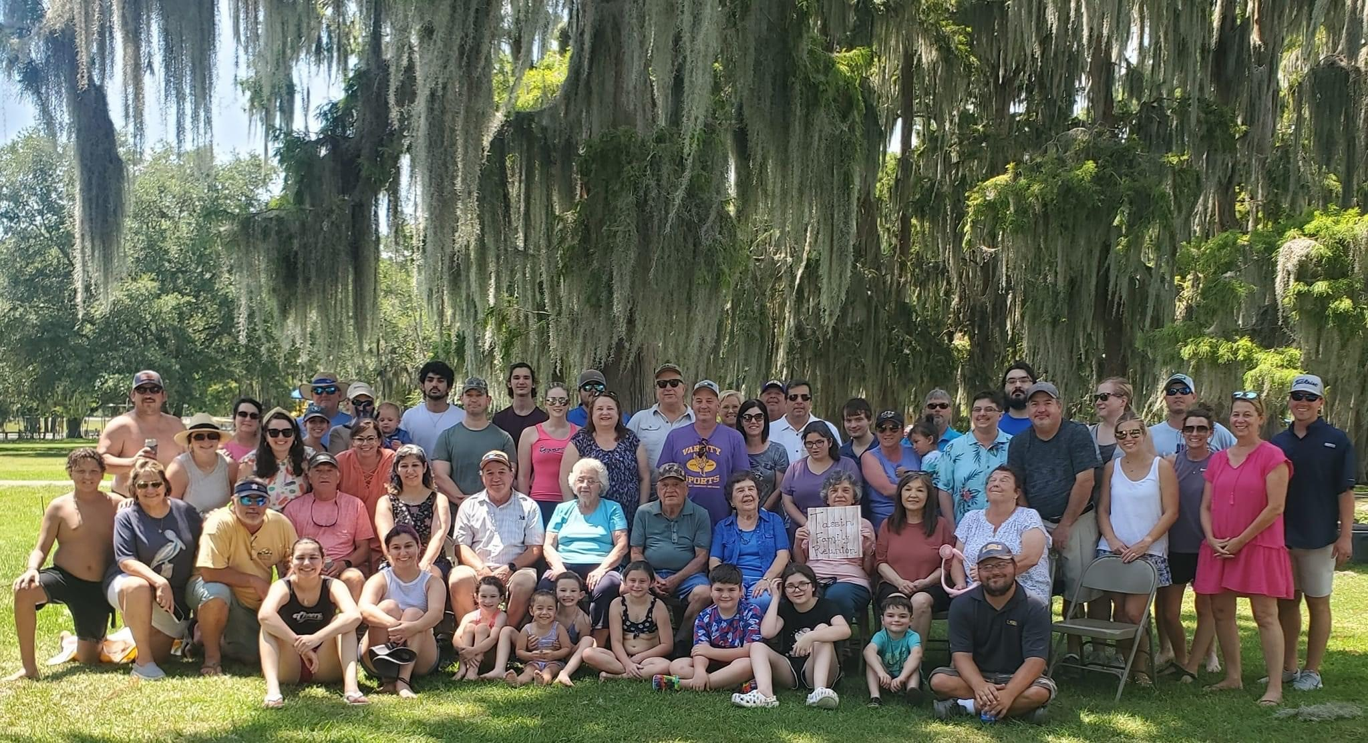
Michael Bertaut,
Healthcare Economist
Blue Cross and Blue Shield of Louisiana
225-573-2092
Michael.Bertaut@bcbsla.com
“Mike Bertaut” on Linked-In
@mikebertaut on Twitter
Sign Up for Our Blog!
www.straighttalkla.com
Louisiana Average Would Be 23 GLP-1 Patients and 8 Type-2 Diabetics in this picture.

