Slide 1
mgma Louisiana | MGMA MISSISSIPPI SOUTHERN SUMMER CONFERENCE beware the road paved with gold: physician joint ventures July 28, 2022 2:30-3:30 P.M.
Clay J. Countryman
Breazeale, Sachse & Wilson, L.L.P.
Clay.Countryman@bswllp.com
225.381.8037

Slide 2
Focus of Presentation
Stark Law and Anti-Kickback risks with physician joint ventures and business arrangements.
Recent Department of Justice settlements and cases involving physician joint ventures and other investments.
Government fraud enforcement focus on Telemedicine arrangements.
Compliance steps and initiatives to address potential liability for physician ownership in and service agreements with joint ventures.

Slide 3
The Stark Law, 42 U.S.C. 1395nn
General Overview
Prohibits a physician from making referrals for certain designated health services (DHS) payable by Medicare to an entity with which the physician (or an immediate family member) has a financial relationship, unless an exception applies.
Prohibits the entity from submitting a claim to Medicare (or another individual or payer) for those referred DHS.
A claim that is made in violation of the Stark Law may make it false or fraudulent, creating liability under the civil False Claims Act.

Slide 4
Designated Health Services (“DHS”)
The Stark Law
Clinical laboratory services.
Physical therapy services
Occupational therapy services
Outpatient speech-language pathology services.
Radiology and certain other imaging services.
Radiation therapy services and supplies.
Durable medical equipment and supplies.
Parenteral and enteral nutrients, equipment, and supplies.
Prosthetics, orthotics, and prosthetic devices and supplies.
Home health services.
Outpatient prescription drugs.
Inpatient and outpatient hospital services.

Slide 5
The Anti-Kickback Statute, 42 U.S.C. 1320a-7b(b)
General Overview
Criminal statute that requires intent of an illegal inducement.
Prohibits the knowing and willful offer, solicitation, payment or receipt of remuneration to induce or reward the referral of business reimbursable under any of the Federal health care programs.
Also prohibits the payment of remuneration intended to induce or reward the purchasing, leasing or ordering of, or arranging for or recommending the purchasing, leasing, or ordering of, any service or item reimbursable by any Federal health care program.
Key safe harbors for physician compensation arrangements:
Personal services and management contracts, 42 CFR 1001.952(d)
Employment safe harbor, 42 CFR 1001.952(i)

Slide 6
Physician-Owned Hospital: Redemption and Reselling Stock Shares
U.S. ex rel. Jennings v. Flower Mound Hospital Partners, LLC (N.D. Tex. Dec. 2021) - Hospital allegedly violated the Stark Law and Anti-Kickback Statute when it repurchased shares from physician-owners aged 63 or older and resold them to younger physicians.
Government: Hospital impermissibly took into account the volume or value of certain physicians’ referrals when it:
Selected the physicians to whom the shares would be resold; and
Determined the number of shares each physician would receive.

Slide 7
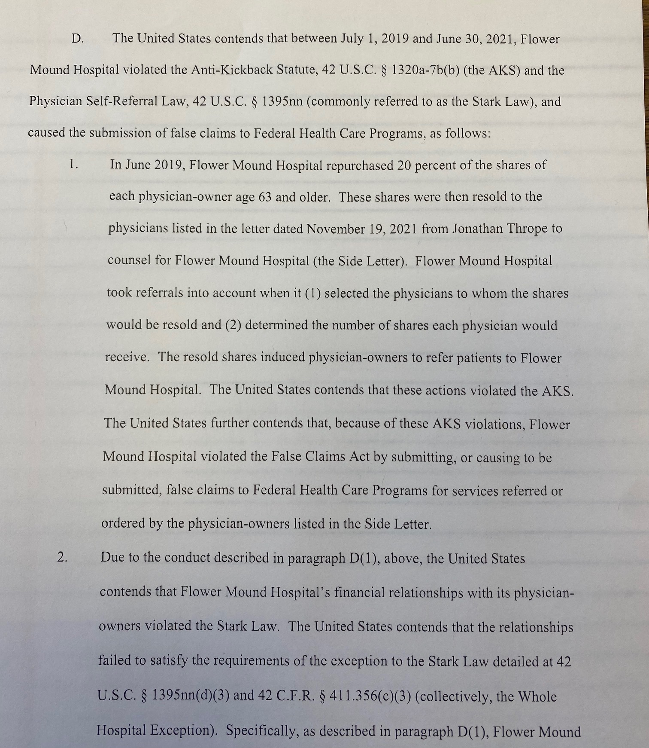
Flower Mound Hospital agreed to settle Stark Law and Anti-Kickback allegations for $18.2 million.

Slide 8
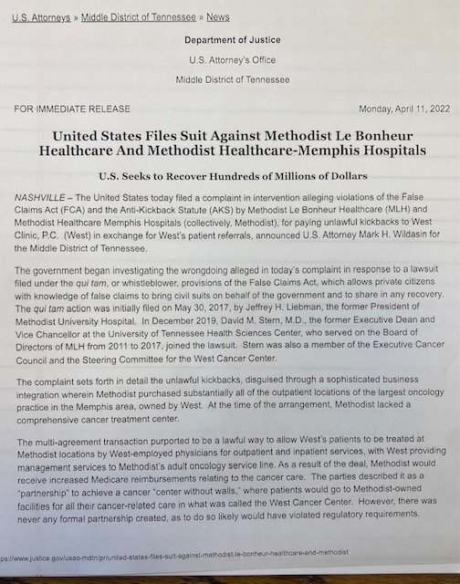

Slide 9
Hospital Purchased Physician Oncology Practice and Infusion Centers
U.S. ex rel. Jeffrey H. Liebmann and David M. Stern, M.D. v. Methodist Le Bonheur Healthcare (M.D. Tenn. 2022) – U.S. intervened in whistleblower case alleging a hospital’s purchase of an oncology practice violated the False Claims Act and Anti-Kickback Statute by paying unlawful kickbacks to physicians.
Government alleged that hospital paid kickbacks to seller physician clinic under a (post-acquisition) management services agreement.
Hospital benefitted by new income streams from facility and professional components related to oncology services, and 340B drug program discounts.

Slide 10
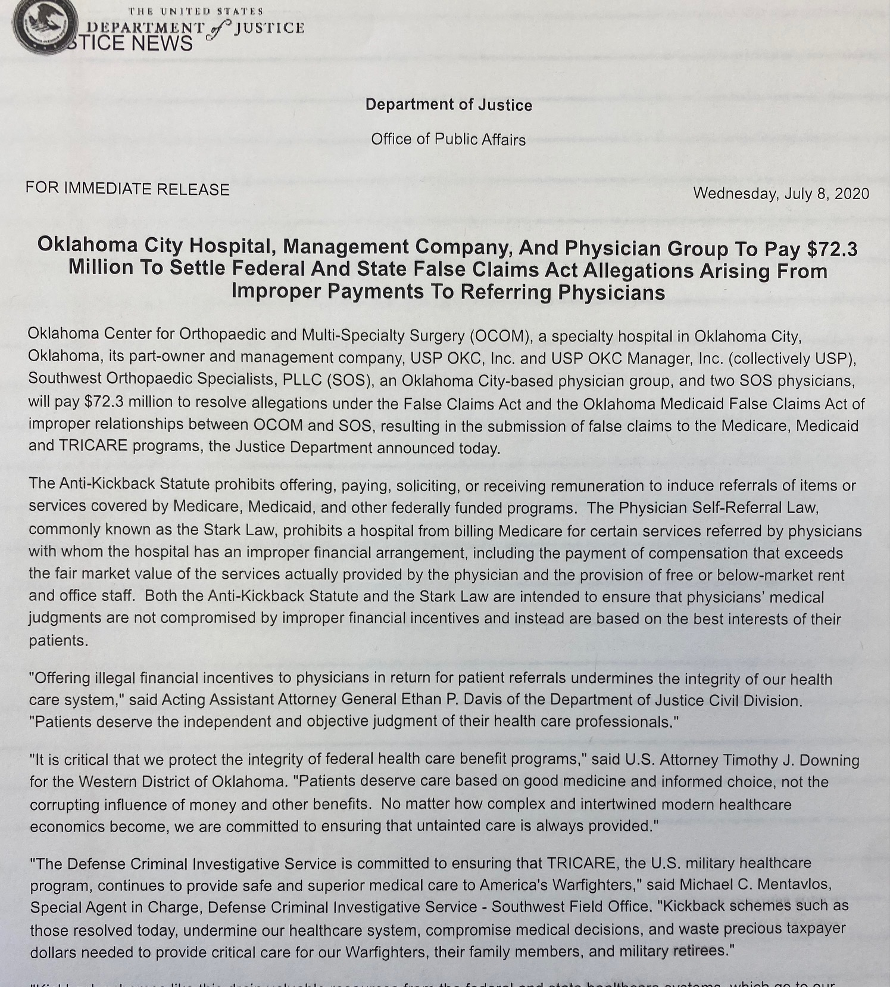

Slide 11
Physician Investment: Equity Buyback Options and Preferential Investment Opportunities
United States ex rel. Allison v. Southwest Orthopedic Specialists, PLLC, et al., (W.D. Okla.) July 8, 2020 – $72,000,000 settlement
Allegations: Orthopedic ASC and a (physician-owned) management company provided the following improper remuneration to an orthopedic group for referrals:
Equity buyback provisions and payments for certain physicians that exceeded fair market value (FMV)
Preferential investment opportunities in connection with the provision of anesthesia services at an orthopedic hospital and surgery center.

Slide 12
United States ex rel. Allison v. Southwest Orthopedic Specialists, PLLC, et al., (W.D. Okla.) July 8, 2020
Allegations also included that the orthopedic physicians received improper remuneration in the form of:
Free or below-fair market value office space, employees, and supplies; and
Compensation in excess of fair market value for the services provided by the orthopedic group.

Slide 13
Physicians Received Investment Returns in MSOs for Ordering Lab Tests
U.S., et al. ex rel. STF, LLC v. True Health Diagnostics, LLC, et al., No. 4:16-cv-547 (E.D. Tex.) May, 2022.
15 additional physicians agreed (33 total) paid $2.8 million to settle allegations of receiving investment returns from 9 management service organizations (MSOs) that were disguised as investment returns for referrals of lab tests to rural hospitals.
MSO investment returns were based on and offered in exchange for the physician’s referrals.

Slide 14
Physician-Owned Hospital: Ownership Eligibility Requirements Include Hospital Use
U.S. ex rel. McGee and Dewey v. Texas Heart Hospital of the Southwest, LLP (E.D. Tex. Dec. 2020) - A partially physician owned hospital and a wholly owned management company subsidiary paid $48 million to resolve claims that the hospital violated the False Claims Act resulting from violations of the Stark Law and the Anti-Kickback Statute.
Allegations included that the hospital violated the Stark Law and the Anti-Kickback Statute by requiring physician owners to satisfy the hospital’s yearly 48 patient-contact requirement in order to maintain ownership in the hospital.

Slide 15
Physicians Offered a “Low-Risk, High-Reward Investment” in Hospital Joint Venture
United States v. Lakeway Regional Medical Center, LLC, (September 28, 2020) - $1.1 million
Whistleblower suit alleged that Lakeway Regional Medical Center (LRMC) induced physicians to refer patients to LRMC by offering them a low-risk, high-reward investment in the joint venture.
The joint venture was formed to purchase and then lease the hospital back to LRMC.

Slide 16
Purchase Price Greater than FMV for Physician-Owned Cardiac Cath Lab
United States and Georgia ex rel. Doe v. Piedmont Healthcare, Inc. June 25, 2020 – $16,000,000 settlement
Case involved 2 separate False Claims Act allegations against Atlanta-based hospital system Piedmont Healthcare, Inc.
Billing Medicare for more expensive levels of inpatient level of care;
Piedmont healthcare system allegedly acquired a cardiology group in violation of the Federal Anti-Kickback Statute paying a commercially unreasonable and above fair market value purchase price for a cath lab partly owned by the cardiology group.

Slide 17
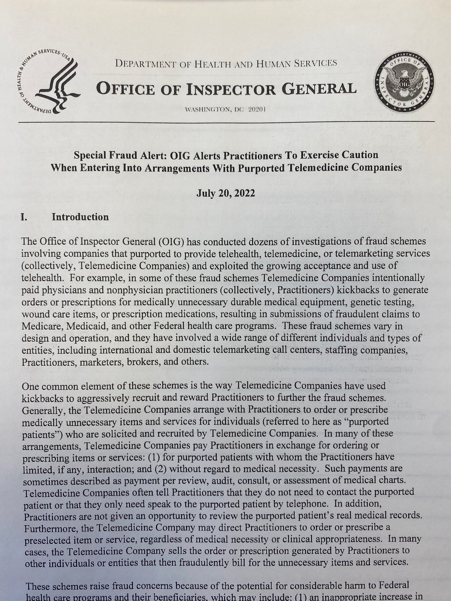
OIG Issues Fraud Alert to Providers Regarding Telemedicine Arrangements

Slide 18
OIG Special Fraud Alert to Practitioners Regarding Telemedicine Arrangements
Addressed fraud schemes of paying physicians and non-physician providers kickbacks for orders or prescriptions for medically unnecessary DME, genetic testing, and wound care items.
Common elements of fraudulent telemedicine arrangements included:
Practitioners are not given an opportunity to review a patient’s medical records.
Practitioners are directed to order a pre-selected item or service.
Common payments are per review, audit, consult, or assessment of medical charts.

Slide 19
QUESTIONS?
Clay J. Countryman, J.D.
Partner
Breazeale, Sachse & Wilson, LLP
Clay.countryman@bswllp.com

