Slide 1
Are you in CHARGE or are you a LEADER?
Cameron Cox, III, MHA, FACMPE
cam@e3c3consulting.com

Slide 2
LEARNING OBJECTIVES
Specify
Specify what is managing/management
Distinguish
Distinguish what is leading/leadership
Understand
Understand the value of both skillsets (and if you have/want them)
Identify
Identify key concepts in the desire to move towards leadership

Slide 3
Let’s take a test to figure out where we are…

Slide 4
Which is correct about good leaders?
Never ask questions
Run from change
Think in a pessimistic form
Judge others

Slide 5
Which is correct about good managers?
A. Gossip
B. Display favoritism
C. Monitor social media of team
D. Blame someone else

Slide 6
If we know….then why do we not do…

Slide 7
Let’s dig into the psyche of this

Slide 8
Quite simply…we get bogged down!

Slide 9
If I say…think of a leader…what do you see in your mind?

Slide 10
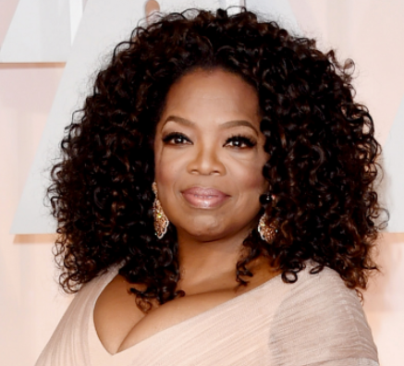
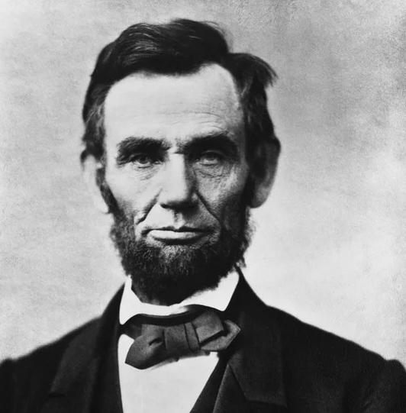
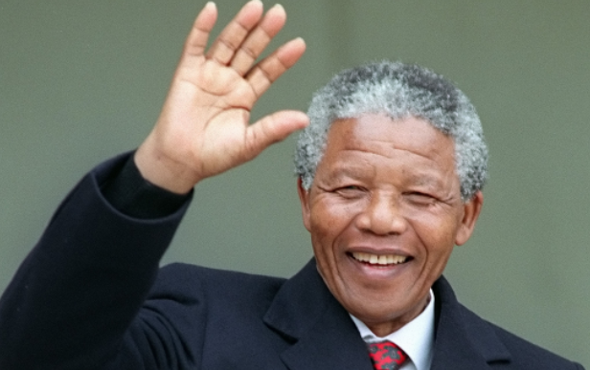
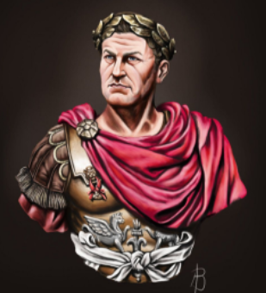
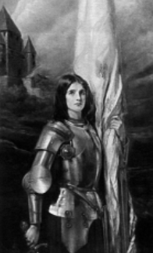
This?

Slide 11
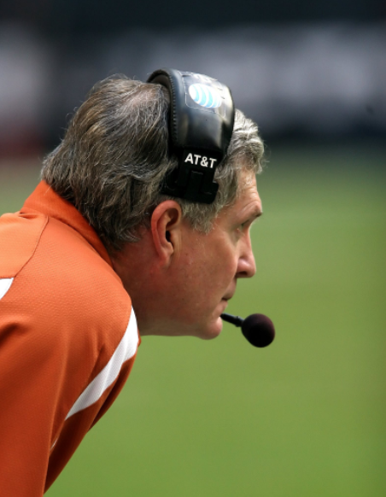
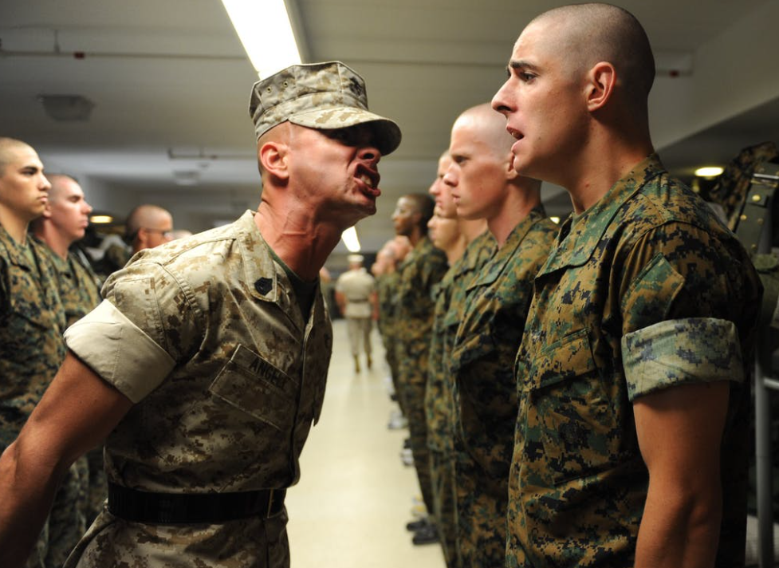
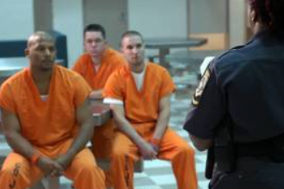
Or maybe this?

Slide 12
If you can’t define it, you can’t understand it.

Slide 13
Start with Miriam-Webster
And might I say…wow, there are many definitions for a leader.

Slide 14
Let’s focus on the person and not the horse…

Slide 15
So, what is a manager?

Slide 16
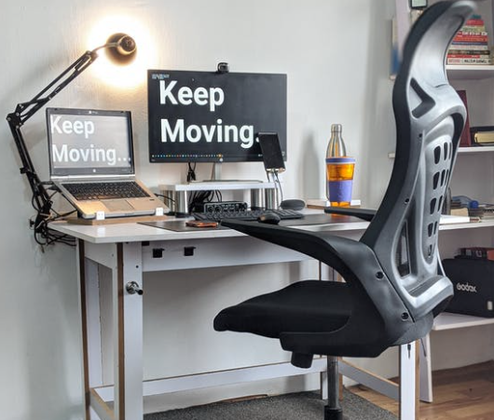
Let’s start with what it means to manage

Slide 17
Common Manager “TITLES” in Healthcare
Administrative
Clinical
Billing Manager
Patient Services Manager
Clinic Manager
Practice Manager
Food Services Manager
Health Information Manager
Clinical Operations Manager
Rehab Manager
Pharmacy Manager
Clinical Trial Manager
Quality Care Manager
Telemedicine Success Manager

Slide 18
What do managers do in healthcare?
Managers typically oversee processes, teams or projects of an organization.
Managers are responsible for the appropriate application of resources to meet the goals of the organization.
Managers plan and implement policy as defined by the organization.

Slide 19
A little more clarity…
Managers focus on the specific mission of the organization and directing their team towards it.
Managers determine best ways to be organized for daily tasks as well as larger projects.
Managers assist in developing talent and solving organizational problems as they arise.

Slide 20
What does it mean to lead

Slide 21
What do leaders do in healthcare?
Leaders have a vision for the organization.
Leaders focus on motivating and supporting the organization forward towards the vision.
Leaders communicate and evolve strategies to pursue the organizational success.

Slide 22
A little more clarity here as well…
Leaders strive to influence the collective towards the organizational strategic objectives.
Leaders maintain a sense of mission in the work of the organization.
Leaders utilize charisma and creativity in problem solving to garner internal support.

Slide 23
Clearly qualities overlap…but are they distinct?
Managers
Leaders
Administers
Plans
Organizes
Solves Problems
Provides Structure
Innovates
Empowers
Creates Vision
Motivates
Embraces change

Slide 24
Where the merge happens
Open communication – transparency
Respect
Honesty and Integrity
Accountability
Commitment
Decisiveness

Slide 25
How do these roles work together?
Both are responsible for communicating changes to the organization and the respective teams. (The what’s, why’s and how’s)
Both are responsible for encouraging internal support and team building to facilitate continued organizational growth.
Both are responsible for accountability…both through actions and expectations.
Both are responsible to establish, maintain, and fertilize organizational culture…allowing it to live fully everyday.

Slide 26
Where can this go horribly wrong?
Leader
Boss
People focused
Encourages commitment
Delegates authority
Innovative collaboration
We
Profit focused
Demands control
Distributes tasks
Administrative domination
Me

Slide 27
So…I can manage…what characteristics help me to lead?
Resiliency interwoven with concern
Flexibility emboldened with creativity
Humility mixed with empathy
Responsibility reinforced with accountability
Fluently communicative with levels of transparency
Courage with the ability to patiently stand

Slide 28
Biggest suggestion…from someone who knows…personal growth!

Slide 29
Suggestions
Search out literature or research on the subject of leadership
Submit to daily affirmations/meditations via email/texts
Take courses exploring leadership development
Participate with professional groups to network and learn from others

Slide 30
In the end…leadership is a gift to be cherished and humbly respected

Slide 31
THANK YOU!
Cameron M. Cox, III, MHA, FACMPE
cam@e3c3consulting.com

